Slide 1
JDBC

Slide 2
Java JDBC is a Java API to connect and execute query with the database. JDBC API uses jdbc drivers to connect with the database.
We can use JDBC API to access tabular data stored into any relational database.

Slide 3
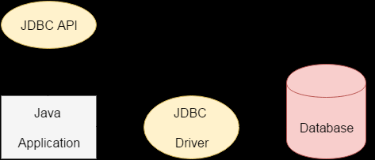
Diagram

Slide 4
Why we use JDBC
That is why Java has defined its own API (JDBC API) that uses JDBC drivers (written in Java language) Before JDBC, ODBC API was the database API to connect and execute query with the database. But, ODBC API uses ODBC driver which is written in C language (i.e. platform dependent and unsecured). .

Slide 5
We can use JDBC API to handle database using Java program and can perform following activities:
Connect to the database
Execute queries and update statements to the database
Retrieve the result received from the database.

Slide 6
What is API
API (Application programming interface) is a document that contains description of all the features of a product or software. It represents classes and interfaces that software programs can follow to communicate with each other. An API can be created for applications, libraries, operating systems, etc.

Slide 7
JDBC Drivers
JDBC Driver is a software component that enables java application to interact with the database. There are 4 types of JDBC drivers:
JDBC-ODBC bridge driver
Native-API driver (partially java driver)
Network Protocol driver (fully java driver)
Thin driver (fully java driver)

Slide 8
JDBC-ODBC bridge driver
The JDBC-ODBC bridge driver uses ODBC driver to connect to the database. The JDBC-ODBC bridge driver converts JDBC method calls into the ODBC function calls. This is now discouraged because of thin driver.

Slide 9
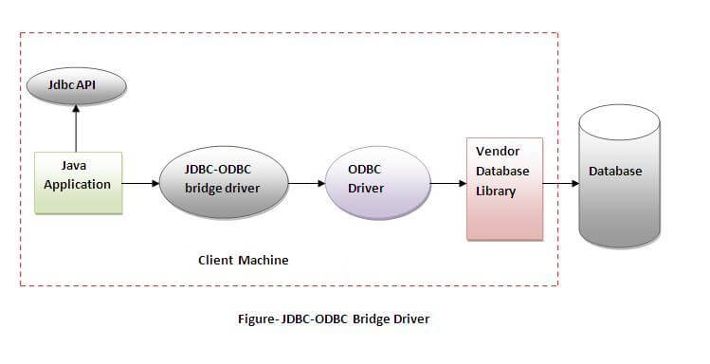

Slide 10
Oracle does not support the JDBC-ODBC Bridge from Java 8. Oracle recommends that you use JDBC drivers provided by the vendor of your database instead of the JDBC-ODBC Bridge.
Advantages:
easy to use.
can be easily connected to any database.
Disadvantages:
Performance degraded because JDBC method call is converted into the ODBC function calls.
The ODBC driver needs to be installed on the client machine.

Slide 11
Native-API driver
The Native API driver uses the client-side libraries of the database. The driver converts JDBC method calls into native calls of the database API. It is not written entirely in java.

Slide 12
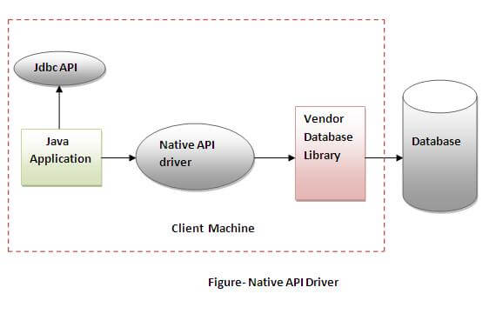

Slide 13
Advantage:
performance upgraded than JDBC-ODBC bridge driver.
Disadvantage:
The Native driver needs to be installed on the each client machine.
The Vendor client library needs to be installed on client machine.

Slide 14
Network Protocol driver
The Network Protocol driver uses middleware (application server) that converts JDBC calls directly or indirectly into the vendor-specific database protocol. It is fully written in java.

Slide 15
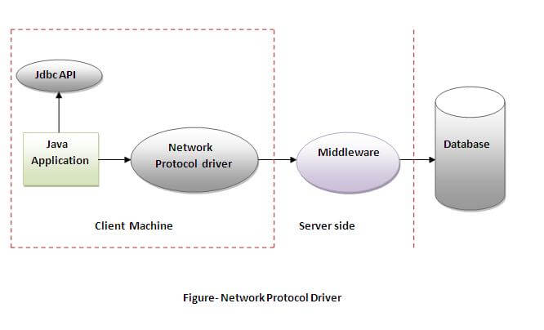

Slide 16
Advantage:
No client side library is required because of application server that can perform many tasks like auditing, load balancing, logging etc.
Disadvantages:
Network support is required on client machine.
Requires database-specific coding to be done in the middle tier.
Maintenance of Network Protocol driver becomes costly because it requires database-specific coding to be done in the middle tier.

Slide 17
Thin driver
The thin driver converts JDBC calls directly into the vendor-specific database protocol. That is why it is known as thin driver. It is fully written in Java language.

Slide 18
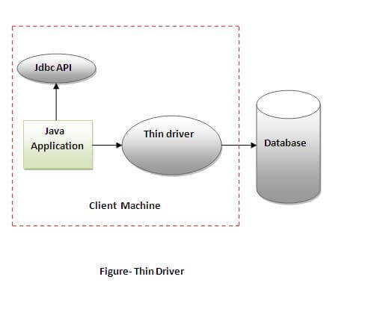

Slide 19
Java Database Connectivity with 5 Steps
There are 5 steps to connect any java application with the database using JDBC. These steps are as follows:
Register the Driver class
Create connection
Create statement
Execute queries
Close connection

Slide 20
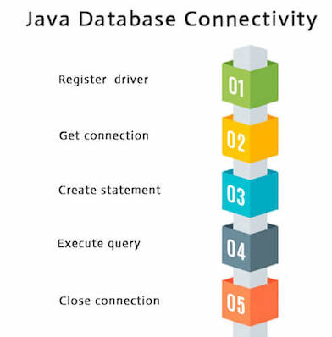

Slide 21
Register the driver class
The forName() method of Class class is used to register the driver class. This method is used to dynamically load the driver class.
Syntax of forName() method
public static void forName(String className)throws ClassNotFoundException

Slide 22
Example to register the OracleDriver class
Here, Java program is loading oracle driver to establish database connection
Class.forName("oracle.jdbc.driver.OracleDriver");

Slide 23
Create the connection object
The getConnection() method of DriverManager class is used to establish connection with the database.
Syntax of getConnection() method
public static Connection getConnection(String url) throws SQLException
2) public static Connection getConnection(String url,String name,String password) throws SQLException

Slide 24
Example to establish connection with the Oracle database
Connection con=DriverManager.getConnection( "jdbc:oracle:thin:@localhost:1521:xe","system","password");

Slide 25
Create the Statement object
The createStatement() method of Connection interface is used to create statement. The object of statement is responsible to execute queries with the database.
Syntax of createStatement() method
public Statement createStatement()throws SQLException

Slide 26
Example to create the statement object
Statement stmt=con.createStatement();
Execute the query
The executeQuery() method of Statement interface is used to execute queries to the database. This method returns the object of ResultSet that can be used to get all the records of a table.
Syntax of executeQuery() method
public ResultSet executeQuery(String sql)throws SQLException

Slide 27
ResultSet rs=stmt.executeQuery("select * from emp");
while(rs.next()){
System.out.println(rs.getInt(1)+" "+rs.getString(2));
}

Slide 28
Close the connection object
By closing connection object statement and ResultSet will be closed automatically. The close() method of Connection interface is used to close the connection.
Syntax of close() method
public void close()throws SQLException
con.close();

Slide 29
DriverManager class
The DriverManager class acts as an interface between user and drivers. It keeps track of the drivers that are available and handles establishing a connection between a database and the appropriate driver. The DriverManager class maintains a list of Driver classes that have registered themselves by calling the method DriverManager.registerDriver().

Slide 30
Useful methods of DriverManager class
Method | Description
1) public static void registerDriver(Driver driver): | is used to register the given driver with DriverManager.
2) public static void deregisterDriver(Driver driver): | is used to deregister the given driver (drop the driver from the list) with DriverManager.
3) public static Connection getConnection(String url): | is used to establish the connection with the specified url.
4) public static Connection getConnection(String url,String userName,String password): | is used to establish the connection with the specified url, username and password.

Slide 31
Connection interface
A Connection is the session between java application and database. The Connection interface is a factory of Statement, PreparedStatement, and DatabaseMetaData i.e. object of Connection can be used to get the object of Statement and DatabaseMetaData. The Connection interface provide many methods for transaction management like commit(), rollback() etc.

Slide 32
Commonly used methods of Connection interface:
public Statement createStatement(): creates a statement object that can be used to execute SQL queries.
2) public Statement createStatement(int resultSetType,int resultSetConcurrency): Creates a Statement object that will generate ResultSet objects with the given type and concurrency.
3) public void setAutoCommit(boolean status): is used to set the commit status.By default it is true.
4) public void commit(): saves the changes made since the previous commit/rollback permanent.
5) public void rollback(): Drops all changes made since the previous commit/rollback.
6) public void close(): closes the connection and Releases a JDBC resources immediately.

Slide 33
Statement interface
The Statement interface provides methods to execute queries with the database. The statement interface is a factory of ResultSet i.e. it provides factory method to get the object of ResultSet.

Slide 34
Commonly used methods of Statement interface:
The important methods of Statement interface are as follows:
1) public ResultSet executeQuery(String sql): is used to execute SELECT query. It returns the object of ResultSet.
2) public int executeUpdate(String sql): is used to execute specified query, it may be create, drop, insert, update, delete etc.
3) public boolean execute(String sql): is used to execute queries that may return multiple results.
4) public int[] executeBatch(): is used to execute batch of commands.

Slide 35
ResultSet interface
The object of ResultSet maintains a cursor pointing to a row of a table. Initially, cursor points to before the first row.

Slide 36
PreparedStatement interface
The PreparedStatement interface is a subinterface of Statement. It is used to execute parameterized query.
Let's see the example of parameterized query:
String sql="insert into emp values(?,?,?)";
As you can see, we are passing parameter (?) for the values. Its value will be set by calling the setter methods of PreparedStatement.

Slide 37
Why use PreparedStatement?
Improves performance: The performance of the application will be faster if you use PreparedStatement interface because query is compiled only once.

Slide 38
Methods of PreparedStatement interface
Method | Description
public void setInt(int paramIndex, int value) | sets the integer value to the given parameter index.
public void setString(int paramIndex, String value) | sets the String value to the given parameter index.
public void setFloat(int paramIndex, float value) | sets the float value to the given parameter index.
public void setDouble(int paramIndex, double value) | sets the double value to the given parameter index.
public int executeUpdate() | executes the query. It is used for create, drop, insert, update, delete etc.
public ResultSet executeQuery() | executes the select query. It returns an instance of ResultSet.

Slide 39
import java.sql.*;
class InsertPrepared{
public static void main(String args[]){
try{
Class.forName("oracle.jdbc.driver.OracleDriver");
Connection con=DriverManager.getConnection("jdbc:oracle:thin:@localhost:1521:xe","system","oracle");
PreparedStatement stmt=con.prepareStatement("insert into Emp values(?,?)");
stmt.setInt(1,101);//1 specifies the first parameter in the query
stmt.setString(2,"Ratan");
int i=stmt.executeUpdate();
System.out.println(i+" records inserted");
con.close();
}catch(Exception e){ System.out.println(e);}
}
}

Slide 40
Java ResultSetMetaData Interface
The metadata means data about data i.e. we can get further information from the data.
If you have to get metadata of a table like total number of column, column name, column type etc. , ResultSetMetaData interface is useful because it provides methods to get metadata from the ResultSet object.

Slide 41
DatabaseMetaData interface provides methods to get meta data of a database such as database product name, database product version, driver name, name of total number of tables, name of total number of views etc.

Slide 42
By the help of PreparedStatement we can retrieve and store the image in the database.
The getBlob() method of PreparedStatement is used to get Binary information, it returns the instance of Blob. After calling the getBytes() method on the blob object, we can get the array of binary information that can be written into the image file.

Slide 43
Java CallableStatement Interface
CallableStatement interface is used to call the stored procedures and functions.
We can have business logic on the database by the use of stored procedures and functions that will make the performance better because these are precompiled.
Suppose you need the get the age of the employee based on the date of birth, you may create a function that receives date as the input and returns age of the employee as the output.

Slide 44
Differences
Stored Procedure | Function
is used to perform business logic. | is used to perform calculation.
must not have the return type. | must have the return type.
may return 0 or more values. | may return only one values.
We can call functions from the procedure. | Procedure cannot be called from function.
Procedure supports input and output parameters. | Function supports only input parameter.
Exception handling using try/catch block can be used in stored procedures. | Exception handling using try/catch can't be used in user defined functions.

Slide 45
Transaction Management in JDBC
Transaction represents a single unit of work.
The ACID properties describes the transaction management well. ACID stands for Atomicity, Consistency, isolation and durability.
Atomicity means either all successful or none.
Consistency ensures bringing the database from one consistent state to another consistent state.
Isolation ensures that transaction is isolated from other transaction.
Durability means once a transaction has been committed, it will remain so, even in the event of errors, power loss etc.

Slide 46
JDBC RowSet
The instance of RowSet is the java bean component because it has properties and java bean notification mechanism. It is introduced since JDK 5.
It is the wrapper of ResultSet. It holds tabular data like ResultSet but it is easy and flexible to use.
The implementation classes of RowSet interface are as follows:
JdbcRowSet
CachedRowSet
WebRowSet
JoinRowSet
FilteredRowSet

Slide 47
Java Database Connectivity with MySQL
To connect Java application with the MySQL database, we need to follow 5 following steps.
In this example we are using MySql as the database. So we need to know following informations for the mysql database:
Driver class: The driver class for the mysql database is com.mysql.jdbc.Driver.
Connection URL: The connection URL for the mysql database is jdbc:mysql://localhost:3306/sonoo where jdbc is the API, mysql is the database, localhost is the server name on which mysql is running, we may also use IP address, 3306 is the port number and sonoo is the database name. We may use any database, in such case, we need to replace the sonoo with our database name.
Username: The default username for the mysql database is root.
Password: It is the password given by the user at the time of installing the mysql database. In this example, we are going to use root as the password.

Slide 48
Let's first create a table in the mysql database, but before creating table, we need to create database first.
create database sonoo;
use sonoo;
create table emp(id int(10),name varchar(40),age int(3));

Slide 49
Example to Connect Java Application with mysql database
import java.sql.*;
class MysqlCon{
public static void main(String args[]){
try{
Class.forName("com.mysql.jdbc.Driver");
Connection con=DriverManager.getConnection(
"jdbc:mysql://localhost:3306/sonoo","root","root");
//here sonoo is database name, root is username and password
Statement stmt=con.createStatement();
ResultSet rs=stmt.executeQuery("select * from emp");
while(rs.next())
System.out.println(rs.getInt(1)+" "+rs.getString(2)+" "+rs.getString(3));
con.close();
}catch(Exception e){ System.out.println(e);}
}
}

Slide 50
To connect java application with the mysql database, mysqlconnector.jar file is required to be loaded.
Two ways to load the jar file:
Paste the mysqlconnector.jar file in jre/lib/ext folder
Set classpath
1)Paste the mysqlconnector.jar file in JRE/lib/ext folder:
Download the mysqlconnector.jar file. Go to jre/lib/ext folder and paste the jar file here.

Slide 51
2) Set classpath:
There are two ways to set the classpath:
temporary
permanent
How to set the temporary classpath
open command prompt and write:
C:>set classpath=c:\folder\mysql-connector-java-5.0.8-bin.jar;.;

Slide 52
How to set the permanent classpath
Go to environment variable then click on new tab. In variable name write classpath and in variable value paste the path to the mysqlconnector.jar file by appending mysqlconnector.jar;.; as C:\folder\mysql-connector-java-5.0.8-bin.jar;.;

Slide 53
Java Database Connectivity with Oracle
To connect java application with the oracle database, we need to follow 5 following steps. In this example, we are using Oracle 10g as the database. So we need to know following information for the oracle database:

Slide 54
Driver class: The driver class for the oracle database is oracle.jdbc.driver.OracleDriver.
Connection URL: The connection URL for the oracle10G database is jdbc:oracle:thin:@localhost:1521:xe where jdbc is the API, oracle is the database, thin is the driver, localhost is the server name on which oracle is running, we may also use IP address, 1521 is the port number and XE is the Oracle service name. You may get all these information from the tnsnames.ora file.
Username: The default username for the oracle database is system.
Password: It is the password given by the user at the time of installing the oracle database.

Slide 55
Before establishing connection, let's first create a table in oracle database. Following is the SQL query to create a table.
create table emp(id number(10),name varchar2(40),age number(3));

Slide 56
import java.sql.*;
class OracleCon{
public static void main(String args[]){
try{
//step1 load the driver class
Class.forName("oracle.jdbc.driver.OracleDriver");
//step2 create the connection object
Connection con=DriverManager.getConnection(
"jdbc:oracle:thin:@localhost:1521:xe","system","oracle");
//step3 create the statement object
Statement stmt=con.createStatement();
//step4 execute query
ResultSet rs=stmt.executeQuery("select * from emp");
while(rs.next())
System.out.println(rs.getInt(1)+" "+rs.getString(2)+" "+rs.getString(3));
//step5 close the connection object
con.close();
}catch(Exception e){ System.out.println(e);}
}
}

Slide 57
To connect java application with the Oracle database ojdbc14.jar file is required to be loaded.
Two ways to load the jar file:
paste the ojdbc14.jar file in jre/lib/ext folder
set classpath
Two ways to load the jar file:
paste the ojdbc14.jar file in jre/lib/ext folder
set classpath

Slide 58
paste the ojdbc14.jar file in JRE/lib/ext folder:
Firstly, search the ojdbc14.jar file then go to JRE/lib/ext folder and paste the jar file here.
2) set classpath:
There are two ways to set the classpath:
temporary
permanent

Slide 59
How to set the temporary classpath:
Firstly, search the ojdbc14.jar file then open command prompt and write:
C:>set classpath=c:\folder\ojdbc14.jar;.;
How to set the permanent classpath:
Go to environment variable then clHow to set the permanent classpath:
Go to environment variable then click on new tab. In variable name write classpath and in variable value paste the path to ojdbc14.jar by appending ojdbc14.jar;.; as C:\oraclexe\app\oracle\product\10.2.0\server\jdbc\lib\ojdbc14.jar;.;
ick on new tab. In variable name write classpath and in variable value paste the path to ojdbc14.jar by appending ojdbc14.jar;.; as C:\oraclexe\app\oracle\product\10.2.0\server\jdbc\lib\ojdbc14.jar;.;

Slide 60
What is NoSQL?
NoSQL encompasses a wide variety of different database technologies that were developed in response to the demands presented in building modern applications:
Developers are working with applications that create massive volumes of new, rapidly changing data types — structured, semi-structured, unstructured and polymorphic data.

Slide 61
A NoSQL (originally referring to "non SQL" or "non relational") database provides a mechanism for storage and retrieval of data that is modeled in means other than the tabular relations used in relational databases. Such databases have existed since the late 1960s, but did not obtain the "NoSQL" moniker until a surge of popularity in the early twenty-first century, triggered by the needs of Web 2.0 companies. NoSQL databases are increasingly used in big data and real-time web applications. NoSQL systems are also sometimes called "Not only SQL" to emphasize that they may support SQL-like query languages, or sit alongside SQL database in a polyglot persistence architecture

Slide 62
Types and examples of NoSQL databases
There have been various approaches to classify NoSQL databases, each with different categories and subcategories, some of which overlap. What follows is a basic classification by data model, with examples:
Column: Accumulo, Cassandra, Druid, HBase, Vertica.
Document: Apache CouchDB, ArangoDB, BaseX, Clusterpoint, Couchbase, Cosmos DB, IBM Domino, MarkLogic, MongoDB, OrientDB, Qizx, RethinkDB

Slide 63
Key-value: Aerospike, Apache Ignite, ArangoDB, Berkeley DB, Couchbase, Dynamo, FairCom c-treeACE, FoundationDB, InfinityDB, MemcacheDB, MUMPS, Oracle NoSQL Database, OrientDB, Redis, Riak, SciDB, SDBM/Flat File dbm, ZooKeeper
Graph: AllegroGraph, ArangoDB, InfiniteGraph, Apache Giraph, MarkLogic, Neo4J, OrientDB, Virtuoso

Slide 64
The Benefits of NoSQL
When compared to relational databases, NoSQL databases are more scalable and provide superior performance, and their data model addresses several issues that the relational model is not designed to address:
Large volumes of rapidly changing structured, semi-structured, and unstructured data
Agile sprints, quick schema iteration, and frequent code pushes
Object-oriented programming that is easy to use and flexible
Geographically distributed scale-out architecture instead of expensive, monolithic architecture

Slide 65
Here is a list of free and widely used NoSQL databases:
MongoDB.
Redis.
Couch DB.
REVENDB.
MemcacheDB.
Riak.
Neo4j.
HBASE.

